Slide 1
Eight tips for working on the master’s thesis
Ivan Harsløf, Coordinator MA, Programme Option Social Work / Child Care

Slide 2
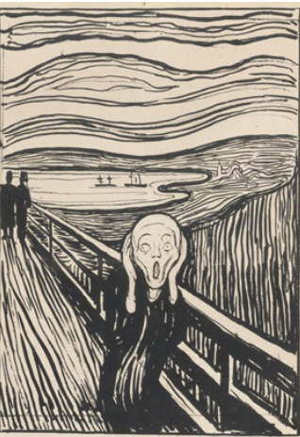
To write a thesis during the Corona pandemic…
Limited access to libraries and places to read.
Constantly changing corona rules
Less social contact on campus
Students with children also have to deal with home schooling, quarantine etc.
In light of this we have tried to gather some advise on how to work on the thesis.
We hope this can help you to reflect and become inspired

Slide 3
1. Remember that every effort counts!
Even though the work on your thesis is more fragmented because you have to deal with other things happening around the «home office,» remember that any period working on your thesis helps.
Just being able to work on your thesis for 30 minutes helps move the project forward..
If you cannot work concentrated for a longer period of time you should instead try to get in several short work sessions.

Slide 4
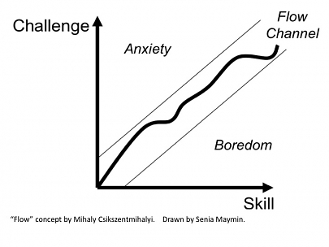
2. Finding «the flow»
Finding the flow is about finding a match between your skill/capacity and the challenges that writing the thesis entail.

Slide 5
2. Finding «the flow» (cont.)
Often the challenges you face seem to surpass your skill and capacity – after all it is the first time you write a thesis on this level.
You should of course use your supervisor actively where there are academic challenges.
It can also be smart to divide a challenging task into smaller parts; try to write down what the task entails – point by point
In this way the subtasks can be easier to take on…

Slide 6
Example: Making a literature review can seem a challenging task.
BUT try to divide it into smaller subtasks:
Search on ORIA for combinations of key words(…)
Order or download the books that match your key words and that seem relevant for your thesis.
Take a quick look at the abstracts of articles that match the key words and choose those that seem relevant.
Download/print the relevant articles
Make a plan of the books and articles that you want to read in-depth (the reading order; what you are looking for in the texts, etc.)
Write your own notes as you read the texts based on how they relate to your thesis questions.
Write across the different notes. How are the various texts approaching the same problem; are there differences/similarities in their approach, empirical findings or other aspects?
Such a division can be done more or less in detail; the point is that each subtask should be manageable.

Slide 7
3. Plan how you work on the thesis
Lists of smaller subtasks are also useful when structuring your work – hour by hour, day by day, week by week..
In a more chaotic work situation it is useful to have a list on what you shall achieve; and it gives a sense of control to cross out items on the list as they are done.
Making, reading and revising your lists on work tasks can be a part of your creative process for the master’s thesis.

Slide 8
4. Use deadlines!
Many students feel that appointments with the supervisor are useful not just because of the comments and discussions, but also that it gives you a deadline to work towards.
Can you give yourself more such deadlines? Can you make an agreement with a co-student, like “by next Wednesday I will give you a new draft for the methods chapter to read.”

Slide 9
5. Use each other
Perhaps the best general advise is to use fellow students:
Read each other’s texts and provide feedback
If you make a work plan for the progress of the thesis; discuss it with each other.. Is this realistic? Should you change the sequence of tasks?
Discuss the challenges; if you are stuck with something it is often useful to just talk about it with someone else. Often their questions can be clarifying and help you back on track.

Slide 10
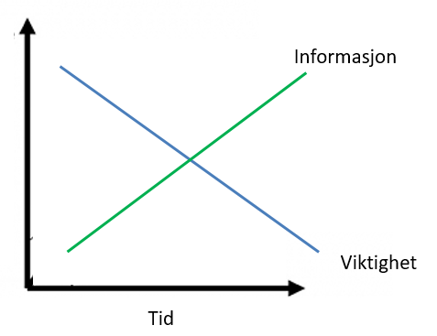
6. Know that you are not the only one struggling with writing a master’s thesis..
Writing a master’s thesis is about making a number of choices (topic, thesis question, theories, methods….)
The most important choices are those you take in the beginning; they decide the direction of the rest of the work.
But the information you need to make these choices you gain by working on the thesis..
This is a dilemma – for everyone!
information
importance
Time
Being conscious of this dilemma can still be mastering strategy, rather than blame yourself for «bad» choices..

Slide 11
7. Find inspiration on your topic
In addition to academic literature it is a good idea to search widely when exploring your topic
Not least it is wise to look into what media has written, the University Library have access to all Norwegian newspapers
It is also possible that your topic has been discussed in a podcast (try to search in your podcast app) or similar.

Slide 12
8. Having writer’s block? Do like the pros
Some writers use a trick where they sit down and just write something to get started; their experience is that after a while something sensible emerges.
Example: I will now write an example, I do not know what it shall be.. Maybe I can write something on the weather? No, it has to be something wise, something scholarly.. Look! I actually made an example!
Others start by writing down questions – that they then try to answer.
Example: Why is this topic important? What motivates me to write about this? What are my preconceptions? What makes me wonder? What makes me curious? What is “at stake” in the field I will write about? Who will gain from the results of my thesis?

