Slide 1
Audio recordings with dictaphone

Slide 2
Audio recordings with dictaphone
Nettskjema dictaphone app can be used for audio recordings in most master’s theses at the Faculty of Social Sciences
Dictaphone should only be used if there are technical problems with the Nettskjema dictaphone app

Slide 3
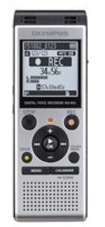
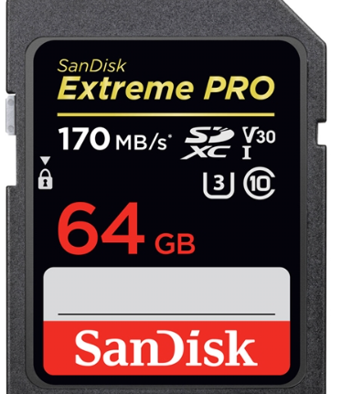
Recording equipment
Dictaphone with memory card should be used
You can borrow a dictaphone in
P48, 1st floor

Slide 4
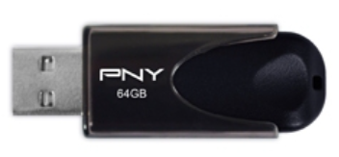
Transferring audio files from the dictaphone after the interview
Transfer the interview from the dictaphone to a USB stick
Encrypt the USB stick
https://ansatt.oslomet.no/en/encryption-mobile-storage-media

Slide 5
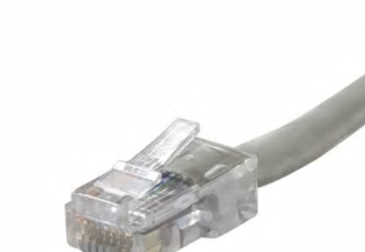
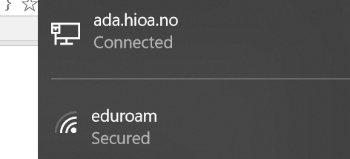
Transcription of the interview
Use a OsloMet computer as far as possible
Pull out the internet cable
Turn off the wireless internet connection:
Disconnect

Slide 6
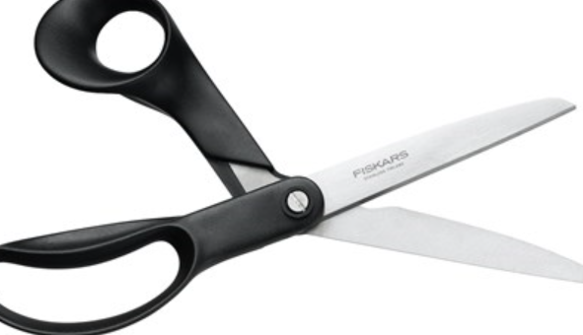
Storage and deletion of audio files
Save the transcribed interview on a USB stick
Encrypt the USB stick
Destroy the memory card
Clean the USB stick
https://student.oslomet.no/en/complete-deletion-content-memory-stick

Slide 7
Anonymisation of the interview
Personally identifiable information will be removed, re-written or categorised
For more information on audio file processing see: https://ansatt.oslomet.no/en/processing-sound-files-research#Lagring

